Slide 1
Website Mastery: Breaking the Jargon.
Over 6 languages covered
By the end of this course you will be able to launch your own website, GUARANTEED.
Over 10 Advanced Topics Including AJAX, Database Support, Cyber Security, much more
By Hassan ibn La’ Ahad

Slide 2
Why web?
Its better than a PowerPoint no?
Every Famous Person Has a website.
every successful company has a Website.
Every Good Teacher has a website.
All code is in English
It’s very rare for a website master to not earn any passive income when developing for themselves, Or a huge income after developing for someone else
Even If you end up in China, homeless, you can still get a job.

Slide 3
Course Overview
5 Years of Web Development experiences condensed into a single course; addressing the misconceptions when dev’s first start this journey.
Over 6 languages covered: HTML, CSS, JS, PHP, SCSS, JQ
This course Covers 10+ Topics: Ajax, JSON, XML, MySQL, Normalization, Databases Security Concerns, SQL MVC System, Appification, DOM Manipulation & Dynamic Rendering, Domains, Hosting & Launching

Slide 4
Table of Contents
Prequel - Convention Codex(for beginners and advanced coders)
The Architect Analogy
Html, the foundation of web | The cementing of the house
What is HTML? Foundation
Semantic coding: <div> or <section>
Linking CSS
Linking JS
Make a website on any computer
Enter the magic of WEBSITES: <a hrefs>

Slide 5
Table of Contents
CSS, Simple but Effective Designs | The painting and furniture of the house
Selectors & Syntax
Playing around with Bootstrap
HSL, RGB, RGBA, Color Schemes
How to casually blend in Advertisements
Responsive Design
People with Disabilities Concern
Professional Dissection, looking at real websites

Slide 6
Table of Contents
JavaScript, Some kind of Coding language
Each line of code is a sentence.
Limitations vs Advantages.
Working with `Document`
Syntax Comparison to Other Languages.
Variables
Arrays
For Loops
Other Loops
The OOP approach
Promises
Threads
PWA
Examples

Slide 7
Table of Contents
SCSS, More organized Design & Better Debugging
Selectors & Syntax
Organization of codes
Mixins
Functions
Responsiveness

Slide 8
Table of Contents
JQ, essentially JAVASCRIPT upgraded: DO MORE; SAY LESS
Selectors & Syntax
Organization of codes
Mixins
Functions
Responsiveness

Slide 9
Authors Notes
Why Web?

Slide 10



Websites that use JavaScript(frontend) and Php(backend)
F: $50k
Etsy: $5.5b
Wiki: $12.8b

Slide 11
Web increases fame & money, experience, or knowledge.
Fame & Money
Experience
Knowledge
If your desire is getting more views on your social media fast, a central blog website, is an amazing way to start your journey and have others view your timeline, especially if you are a serious artist.
Follow my Train of Thought
With more fame, and an existing business, you guessed it: more clients, more reviews, more cash.
CV’s are so boring, most companies only use them to filter out people to lazy to submit one.
At the end of the day, the company might not even read yours or take it seriously!
Building a portfolio website has 304% better chances of landing a job in IT firms, or by any business that requires a website manager.
Websites can be made for foreign languages as well, coaching platforms can be built on any topic in the world.
You know the best way to study a difficult topic, so why not customize some code to fit your brains favorite way of retaining pattern and harnessing new information.

Slide 12
Possible websites
Local fast food joint
E-commerce
Book club
Fan page + messaging
Language
tutor
Book your pharmacy appointment!
Blog
Online game
Streaming website
A new social media?
Hire me

Slide 13
My syntax in this course to teach more, with less words
<p>> means <p> has a closing tag </p>
While I’ll write <img>, <link> the same because they have no closing tags

Slide 14
PRELUDE
The architect analogy

Slide 15
Requirements
Optional , but highly recommended: Install Visual Studio Code
Tip: even if you are on a school computer, you can download it and store it on a flash-drive. This works great as you also install extentions.
Optional extentions:
-Php
-Scss Formater
-Live Sass Compiler
-Xml Tools
-Live Server
-Html Wrapper
-IntelliCode
Not optional: download and install XAMPP, if you have any hopes of using PHP

Slide 16
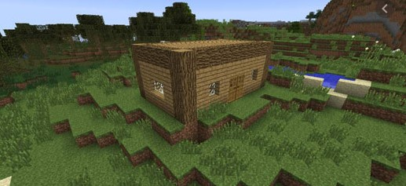
The Architect Analogy
What do you see?

Slide 17
Website === House
It’s a basic house that is built during survival world on Minecraft. Initially the player is very restricted on the first day due to there not being enough time to both gather a surplus of resources and construct a well designed house.
The same is true in web development, when you first start you have limited time to learn all 6 languages covered in this course( there’s definitely, a lot more out there) while constructing your own website. It is unrealistic to both learn and build.
But we have to start somewhere; build a house as quickly as you can. The whole point of this course is that Experience is the best teacher.
The wooden structure(bad html practices) doesn’t mean that you can not break down a few walls later on(refactor) to increase the value to an estate agent.
Please understand that the primal website(house) is UGLY. It has basically no functionality.

Slide 18

The Architect Analogy
What do you see compared to the previous example?

Slide 19
A slightly better website: CSS
When you build your second website, your brain will already consider all the bad things that happened and chances are you will attempt to get rid of your bad practices and mistakes subconsciously the second time you make a house.
CSS is the design of the house, but remember, you cant shove 4 chairs comfortably in a room that only has space for 3. HTML should be designed with CSS IN MIND! NOT THE OTHER WAY AROUND.

Slide 20

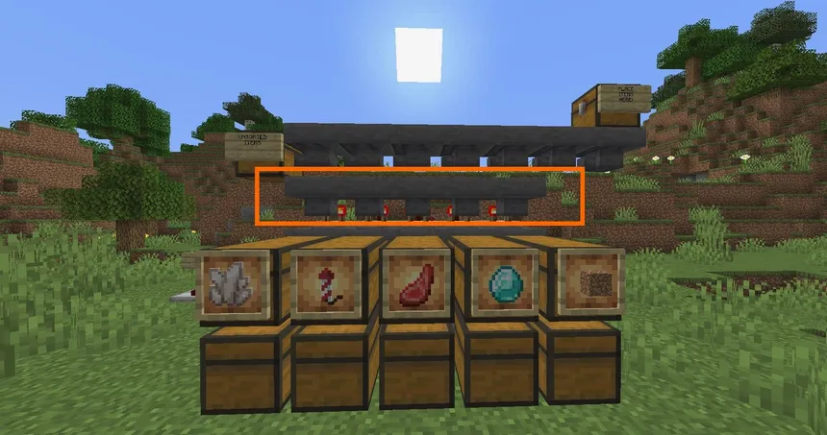
The Architect Analogy
What do you see compared to the previous example?

Slide 21
A better website: JS
Now that you have a house and it looks decent, you have to add some systems make User interface WORK. Imagine a house that doesn’t have any electricity or water in the taps. Learn this scripting language and you’ll be good to go! You need to master how different variables work, loops and especially arrays.
ARRAYS EVERYWHERE
Try making arrays of these things
Recommended books
Timeline.
Important people.
Then turn this array into a (un)ordered list.

Slide 22
HTML
Hyper Text Markup Language

Slide 23

Multiverse Analogy
Skeletal World

Slide 24
Html is a language of containers
<header>
<head>
<body>
<main>
<meta>
Containers with descriptive selectors will help JS and CSS easily Grab them.
<div>
<h1>
<Title>
<h2>
<section>
<p>
<h3>
<h4>
<img>
<h5>
The head handles all the behind the scene documentation.
<h6>
The body is everything you see on a webpage
+ the script just before the body ends (you don’t see it but just like gravity you see its affect.)
<Title>
<link>
<footer>
<script>

Slide 25
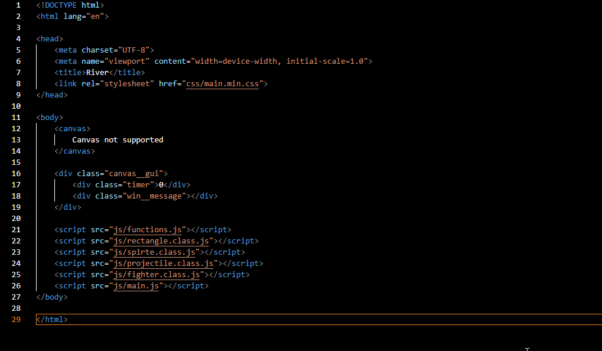
HTML Boilerplate
Jump into the deep-end
What does all this mean?
Line 1 says to the computer that this document type is HTML
<!DOCTYPE html>
Besides line 1 there is a clear pattern.
“Elements” are basically containers that start use ‘<‘ ‘>’ ‘/’ symbols. < dog > blah blah blah </ the same dog >
The biggest element is <html></html>
And the whole webpage lives in here.

Slide 26
Indentation carries significance
Get familiar with the jargon, h1 and p are sibiling elements and their parent is body, these siblings have a grandparent html.
grandfather
father
child
mother
father
brother
sister
mother
grandmother
<html>
<head>
<title>Bread propaganda</title>
</head>
<body>
<h1>Bread is the best</h1>
<p>its cheap and tasty!</p>
</body>
</html>

Slide 27
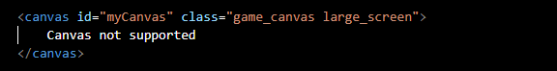
Anatomy of an element
In the previous example, the analogy was that despite the two opening and closing tags appearing to be the same, the grandfather came before the grandmother, same with the father coming before the mother and brother before the sister. The opening tag carries all the necessary information for the code to work.
IDS and Classes(selectors) are used to talk about this element in CSS or JS world.
Typically we use IDS for JS so that we can specifically target a component that needs to do something, while with CSS we use classes to target multiple elements at once.

Slide 28
The correct way to link JS files.
In html, there are two places to link JS, the head or the body.
Normally skeletal script is kept at the end of the body element while script required for the skeletal script to run is kept in the head, so that it will be loaded first.
<script src=‘js/main.js’></script>
JavaScript can also be inserted directly into the <html>, however this is highly discouraged.
<script>
//this is JavaScript World
alert(“Hello world”);
</script>

Slide 29
Properties that are similar.
href
In a nutshell: these props tells where a file sits.
H-ref starts with H, so remember the most popular file in a website should normally be HTML. (we link css too with this)
Here are common instances were they are used.
src
<script src="js/main.js"></script>
<img src="./img/background.png" alt="">
<link rel="stylesheet" href="css/main.min.css">
<a href="posts.html"></a>

Slide 30
The Text Elements
The <p>> element holds paragraphs.
<h1>> , <h2>> until <h6>> are the headings different size headings to use in-conjunction with <p>>.

Slide 31
CSS
Cascading Style Sheets

Slide 32
The selector is
Anything that comes before these brackets{
}
You can select:
element names
IDS
Classes
For example:
Header{
}
Main{
}
Footer{
}
.page{
}
.ad{
}
.products{
}
#music__player{
}
#footer-note{
}
#hero-section{
}

Slide 33
Syntax
CSS rules must be separated by a colon and then end in a semicolon.
Key value pairs
value
Main{
width: 100vw;
height: 100vh;
background-color: green;
color: black;
}
Key

Slide 34
See any element!
2 Dimensions
Main{
width: 100vw;
height: 100vh;
background-color: green;
color: black;
}
Refers to the text

Slide 35
Images
.products{
width: 20vw;
height: 10vh;
object-fit: center;
}

Slide 36
SCSS
Sassy CSS

Slide 37
Notes on usage
When working with SCSS, you separate sections of SCSS into different files, and call them from your main file.
The main file then gets compiled into valid CSS.
All SCSS files should go in
./scss
And they should export to
./css/main.min.css
_resets.scss
_mixins.scss
_functions.scss
_functions.scss
Main.scss
Main.min.css

Slide 38
Notes on usage
_resets.scss
_mixins.scss
_functions.scss
_functions.scss
In SCSS, partials (code separated into different files for organization purposes.) require a prefix “_”.
@import ‘resets.scss’;
However the partial is dropped in the import statement.

Slide 39
Syntax
& means parent
Spacing makes a difference, it separates selectors
Main{
& .intro-paragraph{
}
}
Main{
&.intro-paragraph{
}
}
Main Main.intro-paragraph
Main Main>intro-paragraph
This one is logical.

Slide 40
JS
JavaScript

Slide 41
JS Syntax
Syntax Raw and Effective
Variables
Arrays
Loops
Functions
Classes
JavaScript automatically figures out the datatype when you declare variables. We don’t cover typescript in this course.

Slide 42
Variables
Storing information is always easier than remembering it yourself. Especially when there’s an overload of information. With variables and good naming convention, coding becomes 205% easier.
PascalCaseCanBeConfusingWhenYouAddIds,
IsItIdOrID
With snake_case, its always just lowercase: separated by an underscore.
using_a_naming_convention_doesnot_affect_the_computer_rather_it_helps_humans_read_more_easy.
Your homework is to tell me how these 3 variables are affected?
What can/cant I do?
What are the (dis)advantages of each declaration?
var my_name =“Agnus”;
let my_name =“Agnus”;
const my_name =“Agnus”;

Slide 43
Arrays
Arrays are useful to store a list of homogenous data, and in JS, the type doesn’t matter
Start getting use to the name of “Array brackets” []
The square brackets indicate elements of a list.
Eg test_marks[1]
//74;
var employee_names = [“Agnus”, “Johnny”, “Sarah”];
let test_marks = [53, 74, 34];

Slide 44
For loops
For loops are used when you have repetitive processes.
It saves time coding and allows for the program to execute efficiently.
With for loops, you should know which number you start at,
End at,
And increase/decrease
A integer variable will help traverse through the loop.
var employee_names = [“Agnus”, “Johnny”, “Sarah”];
for (let j = 0; j< employee_names; j++){
console.log(“hello ”+employee_names[j]);
}

Slide 45
Functions
Functions are reusable slices of code that do VERY useful tasks, that would probably be used in different contexts
In the example below, the function fetch_json, takes in two paramaters,
Player,
And file_name
The purpose of this function within a game is to provide the players character with its animation sprites.
function fetch_json(player, file_name= 'samurai_mack'){
fetch(`./json/${file_name}.json`)
.then(response => {
if (!response.ok){
return;
}
return response.json();
})
.then(data => {
console.log(`data from ${file_name} = `, data);
player.set_sprites(data);
})
.catch(error => {
console.log("There was an error with the fetch operation. ", error);
})
}

Slide 46
Classes
class human{
//iv
//c
//a
//m
//aux
}
Instance Variables
Constructor
Accessors
Mutators
Auxiliary Methods

Slide 47
Classes
class human{
//iv
skin_color = 'brown';
hair_color = 'black';
eye_color = 'hazel';
}
Instance Variables
Aka Attributes
Lets look at a human class with some philosophy point of view:
Premise I
Attributes are only the properties that you can see.
Premise II
Attributes are also the properties that you can see the effect of, indirectly.
Just like how you can not see gravity but you can see the effect of gravity.
class human{
//iv
skin_color = 'brown';
hair_color = 'black';
eye_color = 'hazel';
blood_type = 'o';
dna = {};
job = null;
}

Slide 48
Timers
Think of a wee shooting game
setInterval(()=>{
map.make_nazi();
}, 1000)
setTimeout(()=>{
this.restore_hp();
}, 1000)
If you stay alive long enough,once you are not currently being attacked, it can restore your health.
Ensures infinite enemies

Slide 49
Arrow Function
Static function, means this function does not bother caring who SENT it.
() => {
}
(parameter) => {
//code body
}

Slide 50
Non-Static Function
The senders information can be gather from the parameter. Useful for eventListeners
function(parameter) {
//code body
}
function(){
}
Button_world_black.addEventListener(“click” ,
function (){
console.log(“pain the world black now!”);
}
);

Slide 51
Events
Whenever Software interacts with Hardware, We have “events”.
We can interacts with the MOUSE and the KEYBOARD.
If you have not played a PC game, then your eye-hand co-ordination for these inputs will be lacking.
WASD is the most common configuration for PC games,
MOUSE LEFT CLICK can shoot.
MOUSE WHEEL can do some important action.
“keydown”
“keyup”
“click”
IF YOU PRESS THE KEY FOR JUMPING, YOU EXPECT JUMPING TO HAPPEN.

Slide 52
Anatomy of an Event Listener.
What event are you listening for? On Click?
Button_world_black.addEventListener(“click” ,
function (){
console.log(“pain the world black now!”);
}
);

Slide 53
JSON
JavaScript Object Notation

Slide 54
JSON
This is essentially a JavaScript Object, with Key value pairs.
{
"description" : "AutoLaunch Protocols Preregistration",
"name" : "Protocol Preregistration",
"version" : "1.0.0.8"
}
Jargon: “Parsed”

Slide 55
Promises
Help me? Give me a parcel
No
Yes
Return Response.json()
Data (do anything ya like with this)

Slide 56
Load JSON Data into JS world.
url = ‘someJsonFileOnYourPc.json’;
fetch(url)
.then(response => {
if (!response.ok){
return;
}
return reponse.json()
});
.then()
According to some folk, this “fetch api” is easier than older XMLHttpRequest

Slide 57
XML
X Markup Language – Basically Html
<YOUR OWN STUFF>

Slide 58
Syntax
Think of <html> elements but, you aren’t restricted to the ones you already learnt.
<dog>>
<cat>>
<sprite>>
Are valid xml

Slide 59
AJAX
Asynchronous JavaScript XML

Slide 60
Concept
Without refreshing the webpage, this can call another file and send data to this file. Retrieve data too if need be.
There is a POST and a GET ajax request
POST is used to Save changes, for example when you make a YouTube comment, you don’t want the YouTube video to restart.
The GET ajax request also makes sense if you made PHP classes and want to quickly extract data in XML or JSON format.

Slide 61
AJAX with JS
const xhr = new XMLHttpRequest();
xhr.open("POST", "./index.php", true);
xhr.setRequestHeader("Content-Type", "application/json");
const data = {
command: "save",
filename: $file_name, // Replace $file_name with the appropriate variable
data: $content.innerHTML // Replace $content with the appropriate DOM element
};
xhr.onreadystatechange = function () {
if (xhr.readyState === XMLHttpRequest.DONE) {
if (xhr.status === 200) {
console.log("response", xhr.responseText);
document.getElementById("btn__open").click();
alert(“Ajax is running");
} else {
console.error(`Error: ${xhr.status} ${xhr.statusText}`);
}
}
};
xhr.onerror = function () {
console.error("Request failed");
};
xhr.send(JSON.stringify(data));

Slide 62
AJAX with JQ
input
Ajax.({
“url” : “./ajax.handler.php”,
“method” : “POST”,
“data” : {
“first_name” : $(“.first_name”).value();
},
“success” : (response) => {
console.log(response)
},
“error” : (jqXHR, textStatus, errorThrow) => {
console.log("Error: " + jqXHR + " " + textStatus + " " + errorThrow);
}
})
output

Slide 63
JQ
J-Query

Slide 64
Its an upgrade when it needs to be
Just because JQ is an upgrade to JS, doesn’t mean you need to learn all of JQ at once. Any JS that you type in a JQ file is valid JQ.
As long as your JavaScript foundation is strong, you have nothing to worry about.

Slide 65
Requirements
Basic understanding of JS.
A JQ <script>> linked inside the <head>>
Every line in JQ MUST end in a semi-colon ;
If you already practiced this in JS (good practice) then its not easily forgotten.
I prefer downloading the current JQ version (a single file with compressed code)

Slide 66
JS but better
To grab an element in JQ, its a lot more simple than with JS.
Observe:
Const my_heading = document.querySelector(“main .heading”);
my_heading.addEventListener(“click”, () => { alert(“redirect to drakes new album”);
window.location.href = ‘youtube.com’;
});
Const my_heading = $(“main .heading”);
my_heading.click(() => { alert(“redirect to drakes new album”);
window.location.href = ‘youtube.com’;
});

Slide 67
PHP
Hypertext Preprocessor

Slide 68
Php Syntax
When you learn Php, you can finally start on the journey of getting cash, so remember that all variables start with
$ symbols.
Php’s is mostly like JavaScript, but when variables are declared its more static, like Java.
String $website_name
int $age
private array $supported_modules

Slide 69
Arrays
Arrays are useful to store a list of homogenous data, and in JS, the type doesn’t matter
Start getting use to the name of “Array brackets” []
The square brackets indicate elements of a list.
$test_marks[1]
//74
String[] $employee_names = [“Agnus”, “Johnny”, “Sarah”];
Int[] $test_marks = [53, 74, 34];

Slide 70
For loops
For loops are used when you have repetitive processes.
It saves time coding and allows for the program to execute efficiently.
With for loops, you should know which number you start at,
End at,
And increase/decrease
A integer variable will help traverse through the loop.
$employee_names = [“Agnus”, “Johnny”, “Sarah”];
for ($j = 0; $j< employee_names; $j++){
echo (“hello ”.$employee_names[$j]);
}

Slide 71
Scandir()
Read in all files/folders
$all_files = scandir(“./img/”);
For (int $i = 0; $i < count($all_files); $i++ ){
Echo “image = ” . $all_files[$i];
}

Slide 72
MySQL Database
Normalized Database

Slide 73
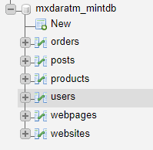
enter DATABASES
Storage medium used to store vast amounts of data/information.
Analogy
Every family(website) has at least one fridge(database) in there home, to guard food(data) from pests(third-parties)

Slide 74
enter DATABASES
Storage medium used to store vast amounts of data/information.
If you look at your National ID CARD
You will notice that you have various "fields" relating to categories that classify you. You would be one ROW.

Slide 75
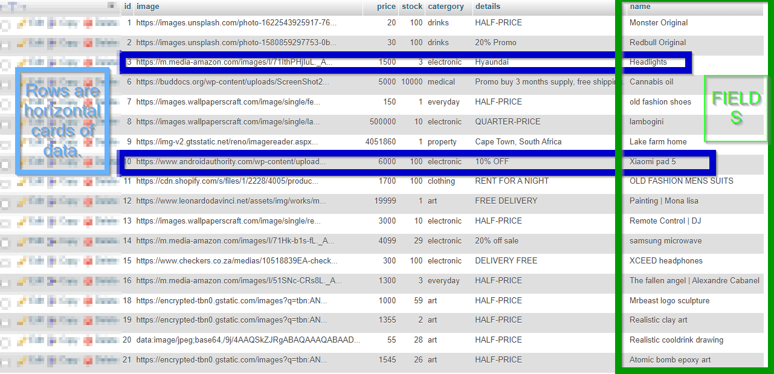
The layout consists of various tables, each built by fields and rows.

Slide 76
If you look at your National ID CARD
You will notice that you have various "fields" relating to categories that classify you. You would be one ROW.
Your bestie would be another ROW.
Your mother would make another.
Many of these Rows will fill up a table.
And so we have a basic database.
Percs ->>>
Two Tables may be linked together through a relationship.
There are three types of relationships
1) One-to-One
2) One-to-Many
3) Many-to-Many
--

Slide 77
Normal Forms
What are Normal Forms anyways?
They are protection against bad data storage.
Normal forms have a specific structure that leaves no room for data redundancy and data ambiguity
Remembering the database-fridge analogy: Without Normal levels, the fridge would have peanut butter next to cheese (unorganized); empty sauce bottles (old data); cockroaches and mice crawling on the food (security leaks)

Slide 78
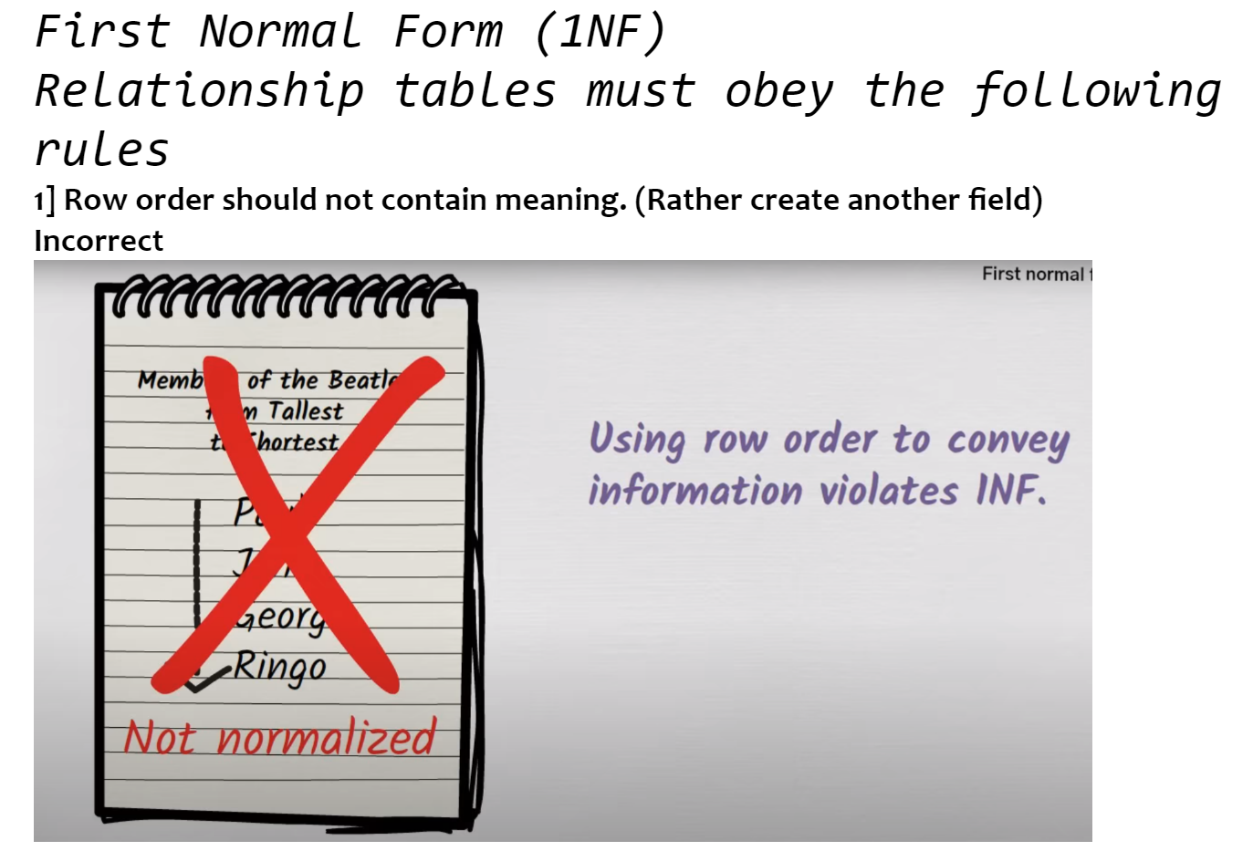
1NF

Slide 79
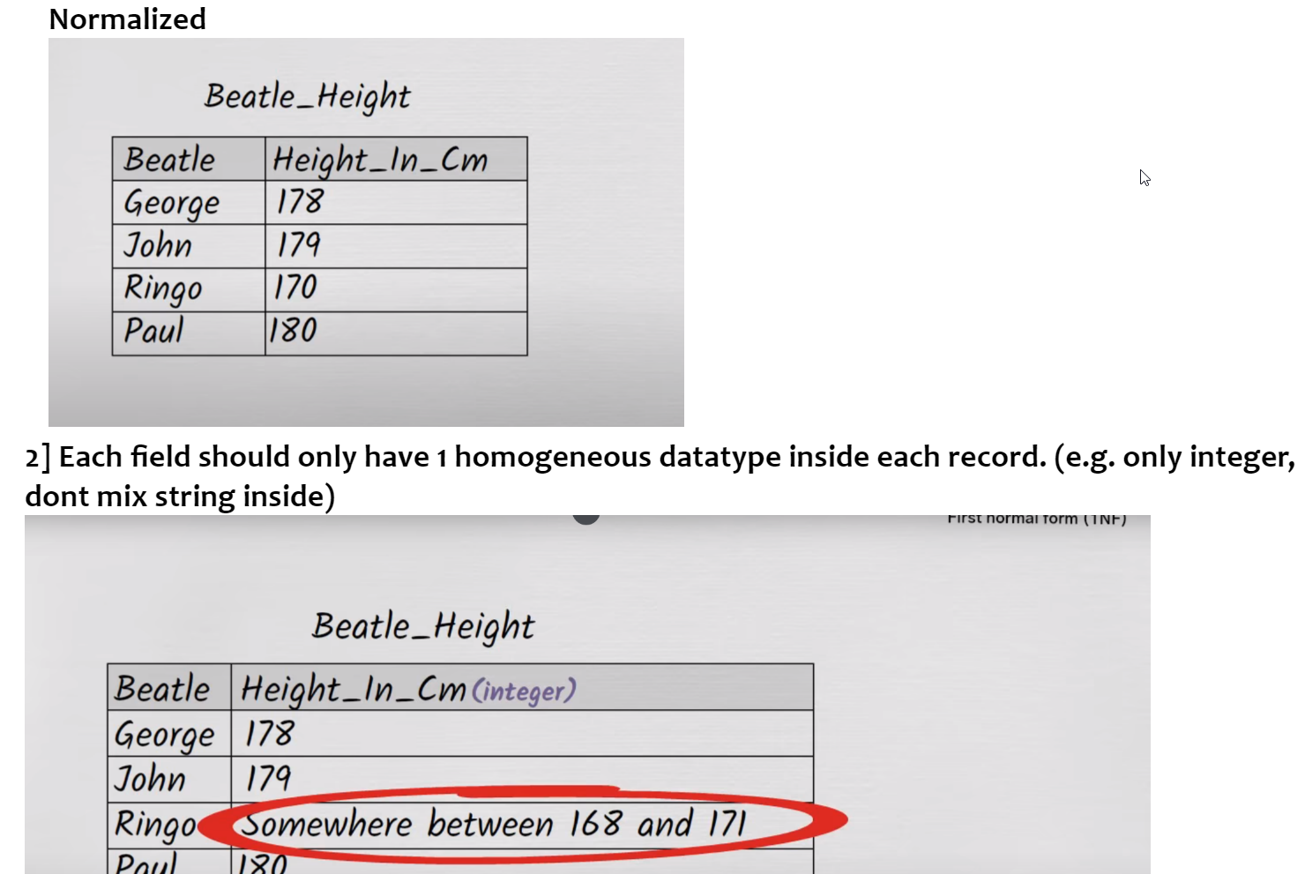
1NF

Slide 80
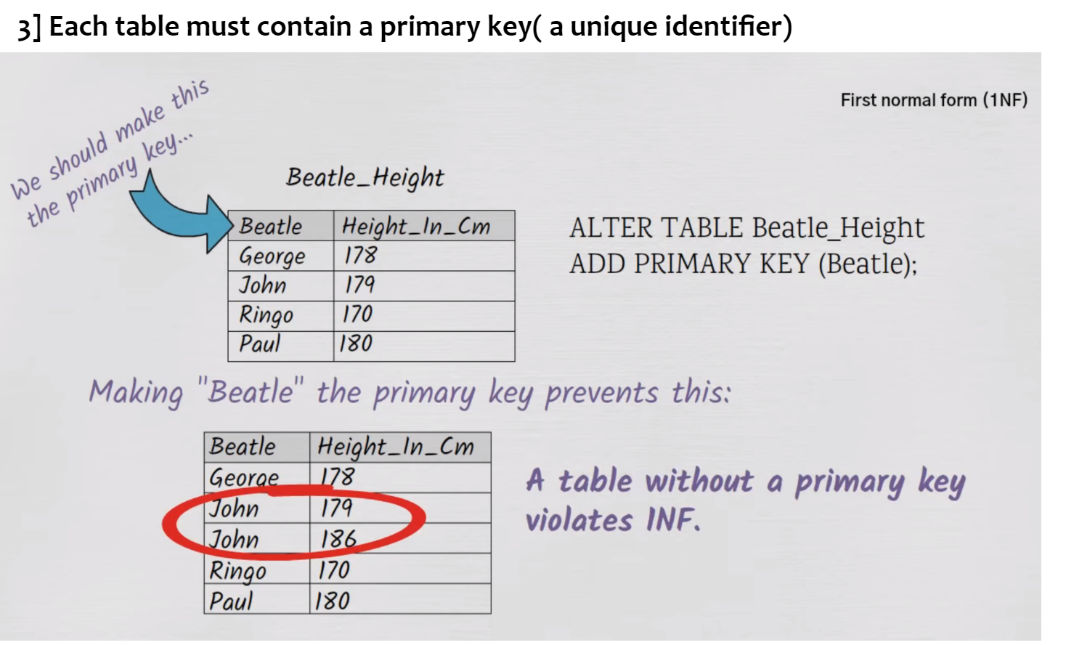
1NF

Slide 81
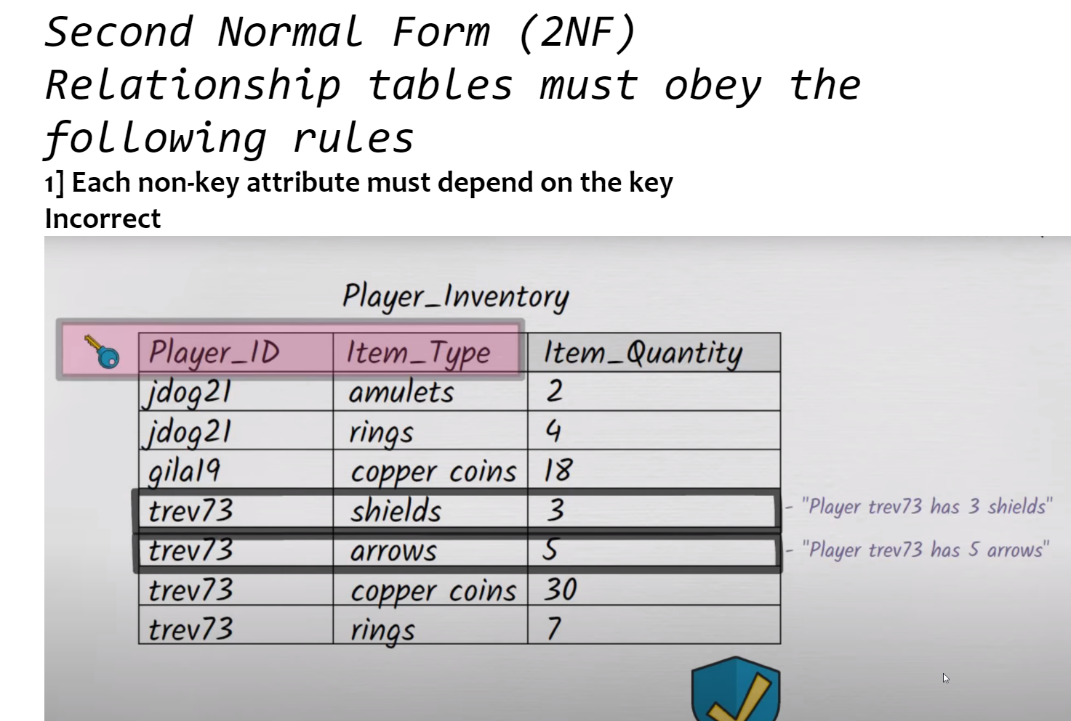
2NF

Slide 82
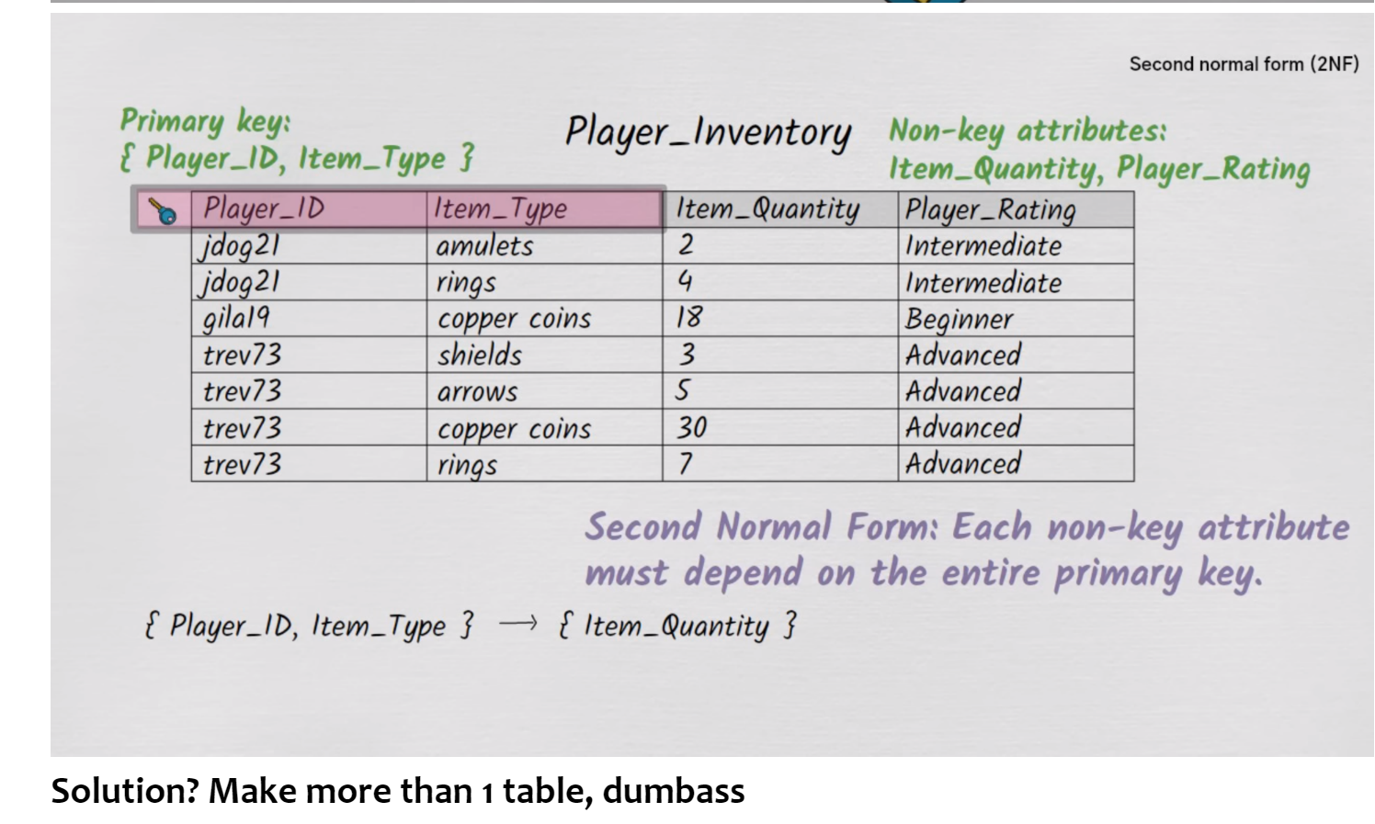
2NF

Slide 83
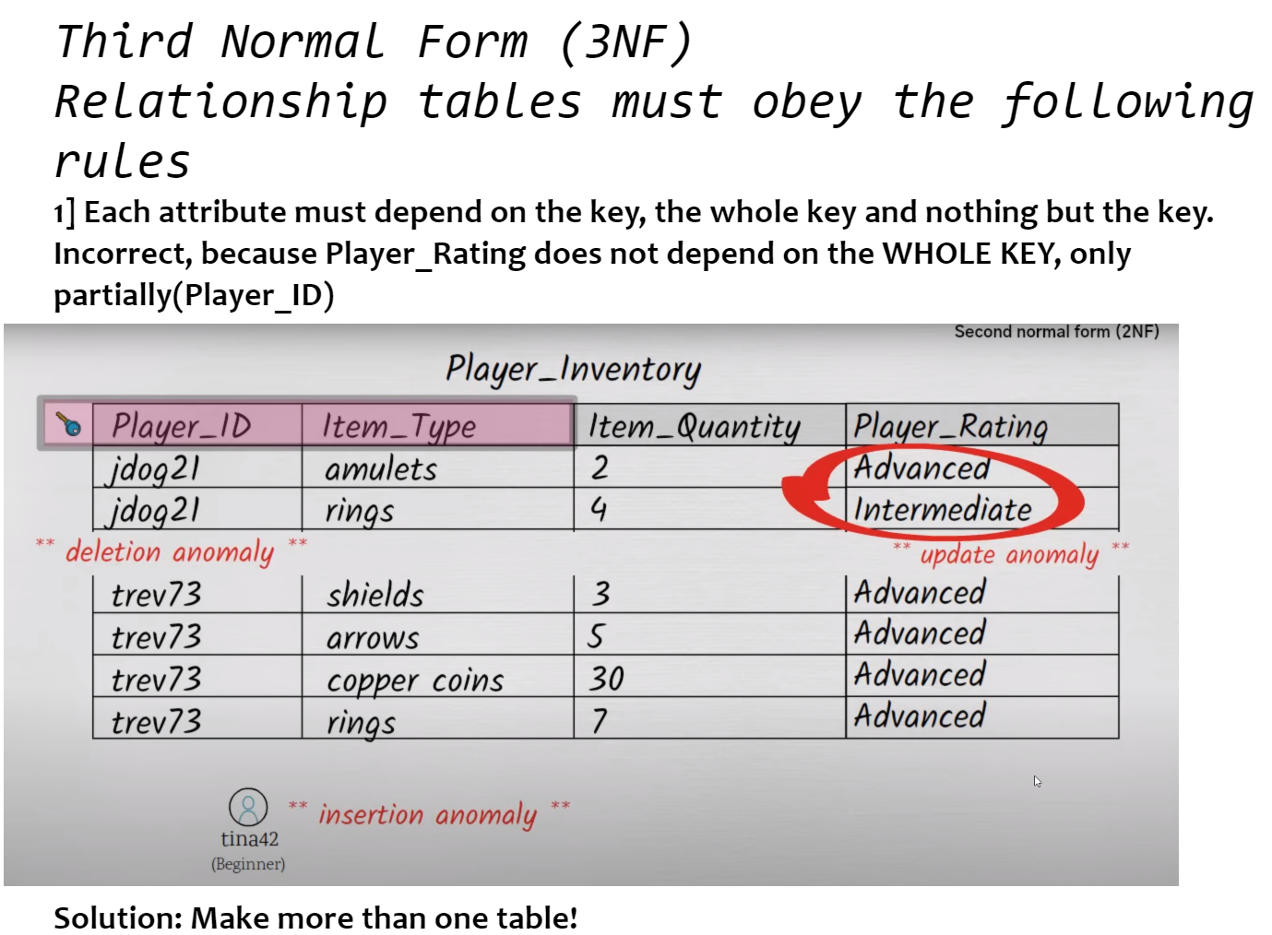
3NF

Slide 84
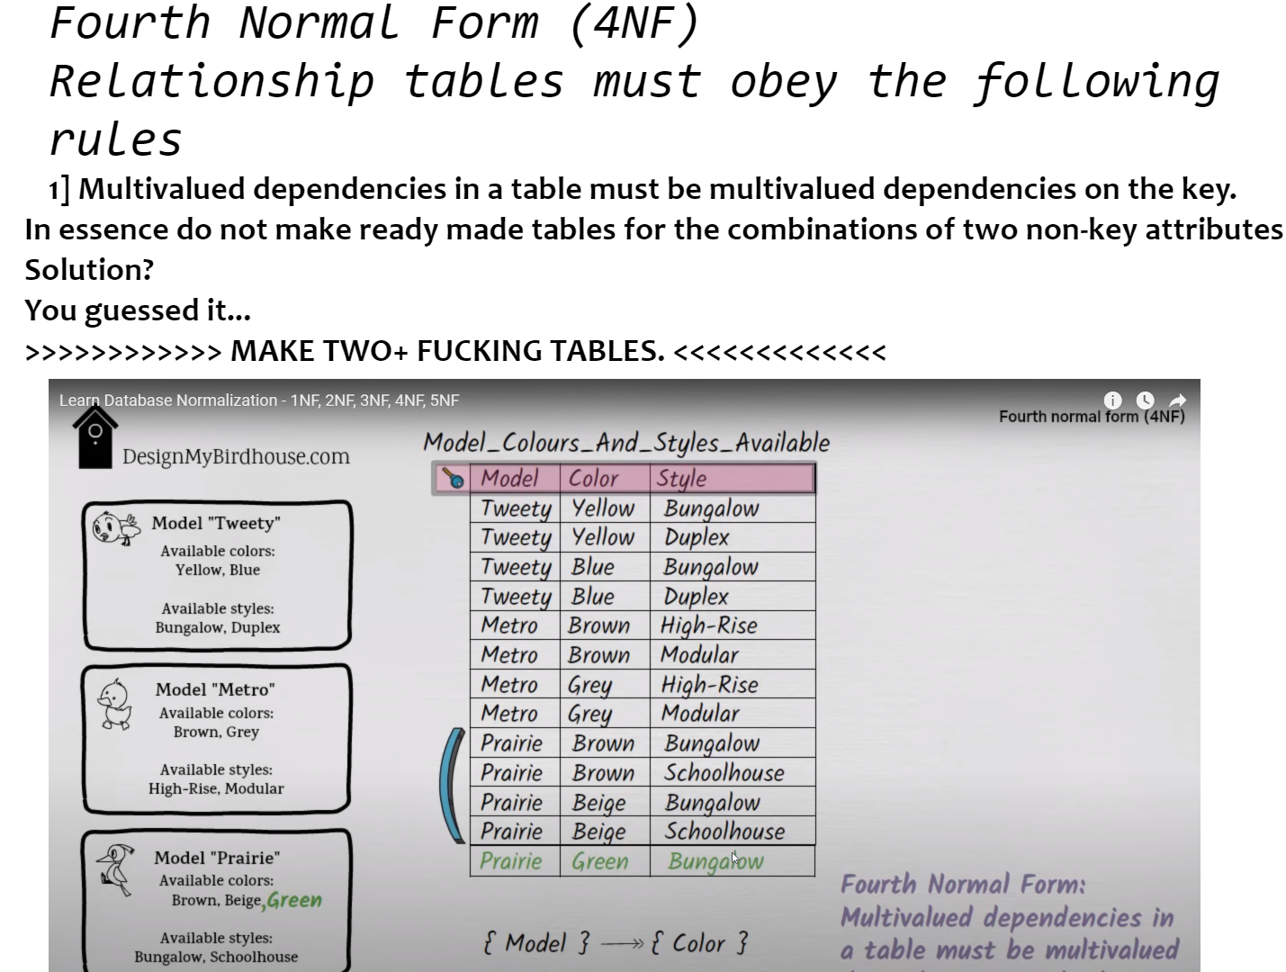
4NF

Slide 85
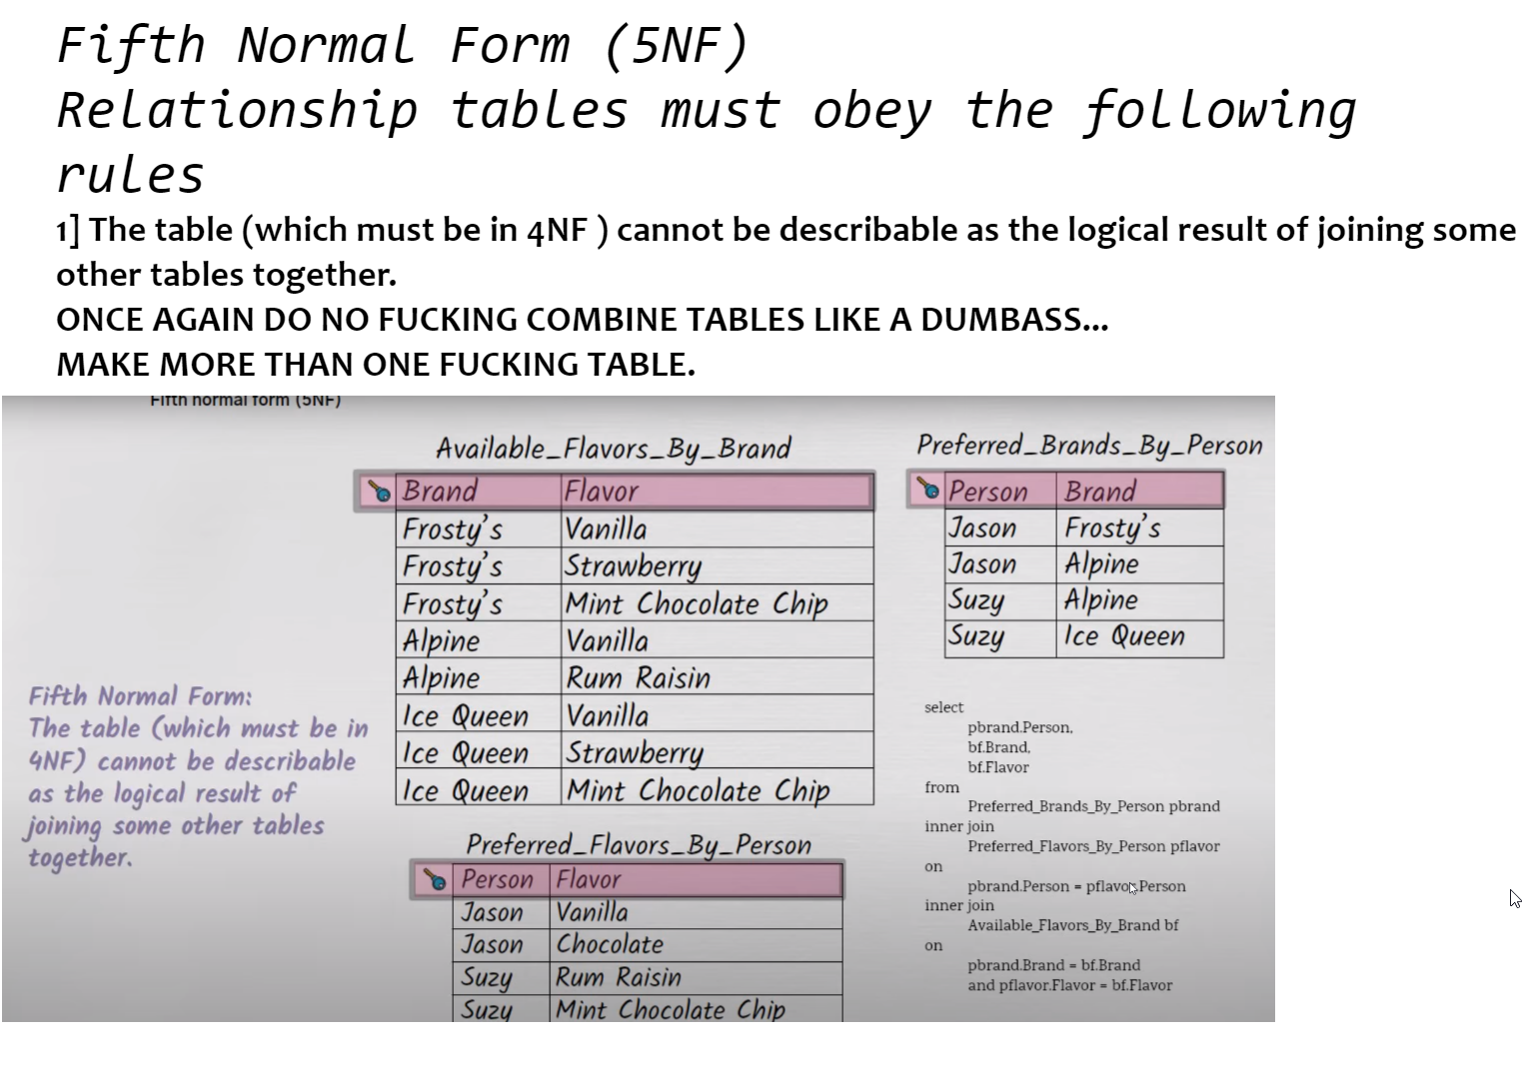
5NF

Slide 86
SQL
Database Management System

Slide 87
SQL Syntax
Syntax should be self-explanatory (that’s why it’s in English)
SELECT -> determines which columns to include
FROM -> determines which tables to include
INSERT ->adds records to a table
DELETE ->removes records from a table (@Warning@)
ORDER BY -> sorts the table based off one field or more (you can specify ASC OR DESC)
HAVING -> filters out unwanted groups
GROUP BY -> used to organize data into groups based on one or more columns; It is commonly used in conjunction with aggregate functions (such as COUNT, SUM, AVG, MAX, MIN) to perform calculations on each group of data.

Slide 88
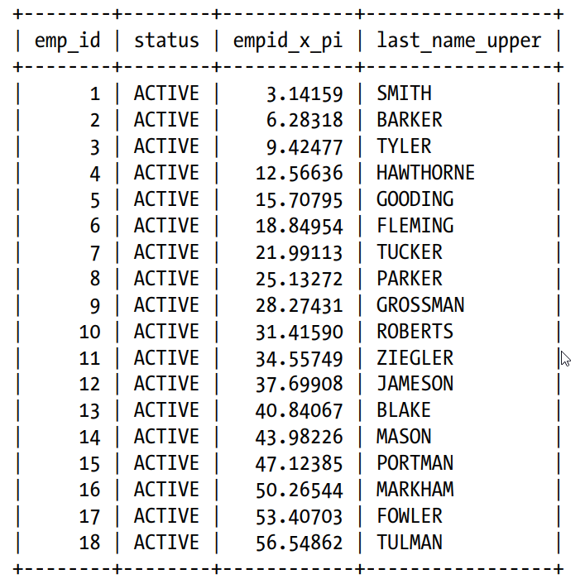
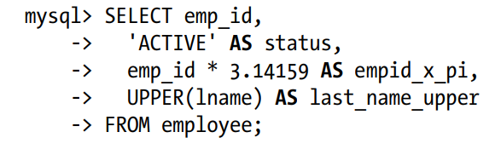
alias
The alias is very good method of improving readability, you can morph any weird column names, and cast your own name upon them. It is considered good to use the keyword AS... to clearly state you are using a Alias.

Slide 89
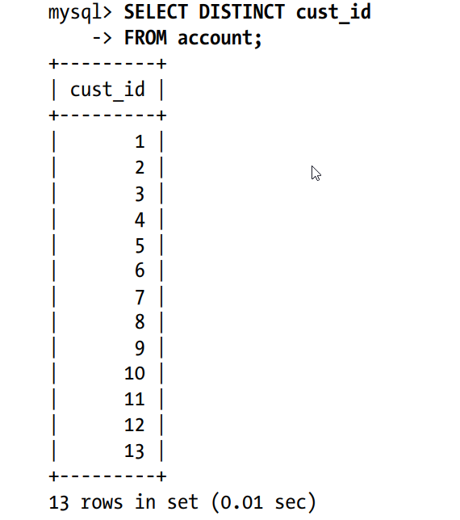
Add this keyword distinct after a column name, to specify that you no longer require any duplicate values in the final results. Only one record will in turn show up

Slide 90
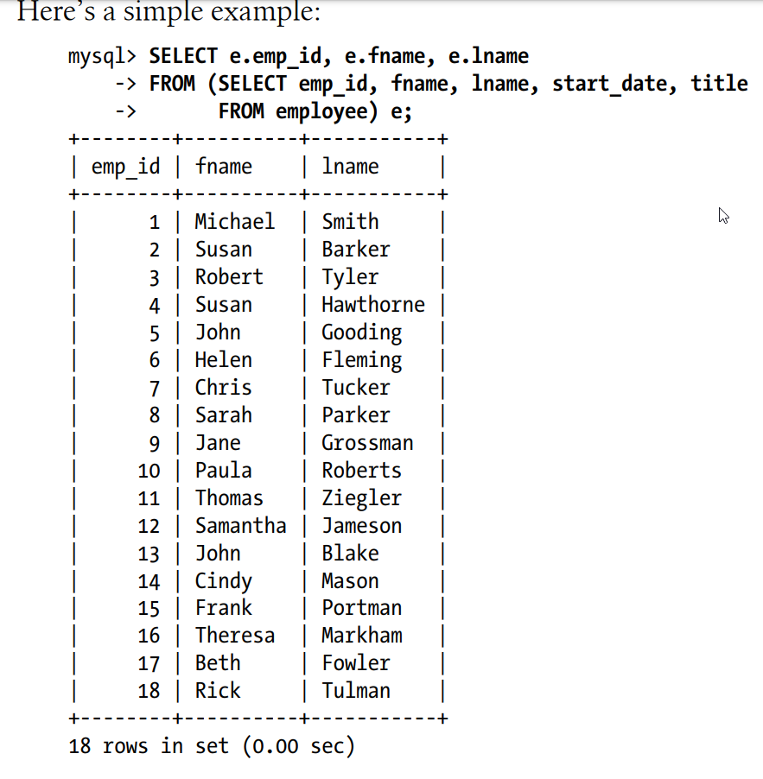
Sub-queries
A subquery can have you work a modified table for all other clauses.
Real world example: From all the people who passed the HSK test，who qualifies for the trip?

Slide 91
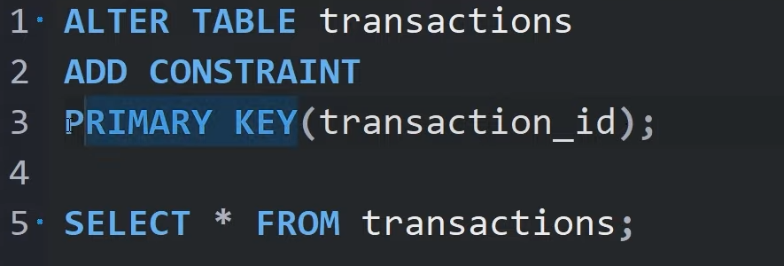
Constraints
PRIMARY KEY // FOREIGN KEY

Slide 92
DBMS
Database Management System

Slide 93
MVC System
Model View Controller System

Slide 94


Slide 95
Model
Interacts directly with the database; for data to be inserted, modified or viewed, the Model must be the middle-man.

Slide 96
View
Takes data and returns HTML Widgets to display them.

Slide 97
Controller
Passes sanitized form data into the model to be saved to the database after.
Require knowledge of the respective database tables structure.

